Slide 1

Mental Health at Workplace

Slide 2
Team :
Likhith Sai Chaitanya 00764343
Phobi Shrestha 00769089
Sai Rohith Sunkara 00770130
Sivaleela Yaramala 00760105
Udith Kumar Tene 00763052

Slide 3
Introduction
With the development of new data sources and analytical methods, data science has become more and more prevalent in the healthcare industry. In terms of mental health, there is a huge unmet demand in the world. Data science can contribute to our understanding of mental health issues. We may use data science to more fully comprehend and successfully apply treatments for mental health issues.

Slide 4
Challenge
How to handle mental health at the workplace
Mental Health affects mental, psychological, and social well-being. It also affects how we think, feel and act. It also helps us in determining how we handle stress by relating it to others. The impact of mental health on an organization can mean a lot of things: an increase in absent days from work, Decrease in productivity. In the US, approximately 70 percent of adults with depression are in the workforce. Employees with depression will miss a lot of days.

Slide 5
Solution
This problem can be solved using Mental Health First Aid. It helps participants to notice and support individuals who are suffering from mental health. It teaches employees communication and support skills which can help people suffering from mental health.
Research shows that employees who used first aid have increased awareness of mental health among themselves and their co-workers. It allows them to recognize the signs of someone who is struggling with mental health and teaches them the skills to when and where to reach out.
Moreover, they conduct an Employee Assistance Program which focuses on mental and physical health. These measures can help create a healthy and productive work environment that reduces the stigma associated with mental illness.

Slide 6
User Stories
As an employee I want to register into the system so that I can access the system.
As an employee I want to login to the system so that I can view my projects and tasks assigned.
As an employee I want to report any issue regarding mental illness in the portal to the mental health awareness team.
As a member of the mental health awareness team I will look into the portal and try to solve the issue.
As a database administrator I need to check whether the data regarding mental health is properly being updated into the backend or not.
As a data analyst I want to find the percentage of employees suffering from mental health related issues so that necessary precautions can be taken.
As a data scientist I want to create a model so that it can predict if any employee is suffering from mental illness by providing his/her symptoms.
As an app developer I want to create a good and interactive user interface so that every user can access it easily.
As a team leader I want to make sure that every task of the project is going without any issue.
As an employee I want to logout my account so that no one can access it except myself.

Slide 7
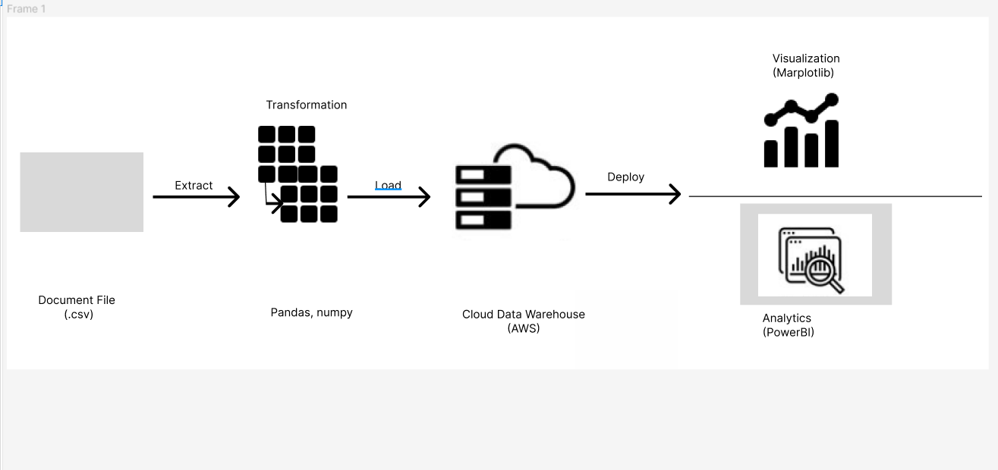
Graphical View of ETL Tools :

Slide 8
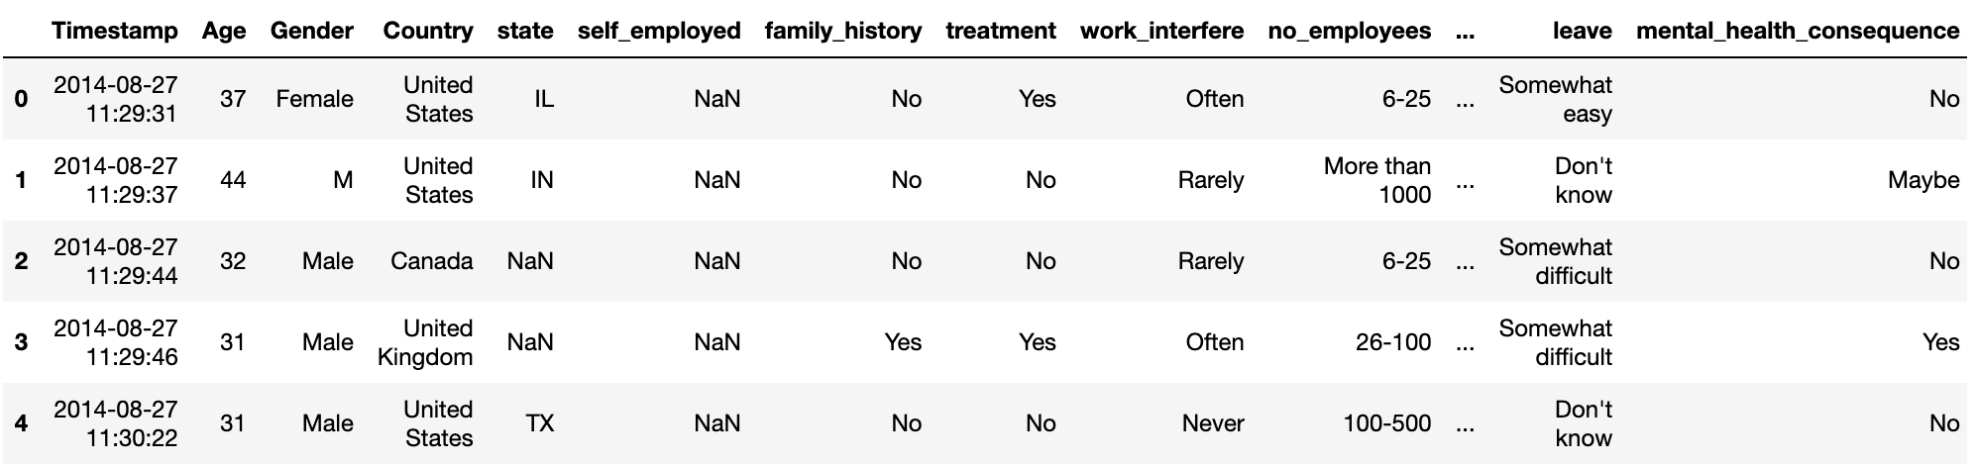
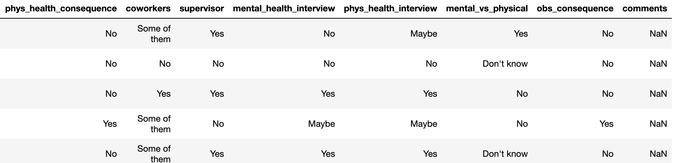
Data

Slide 9
Tools that we are going to use to solve this problem :
JUPYTER : We use jupyter to load our dataset , train and test the data using machine learning algorithms to predict the accuracy.
Numpy, Scikit-Learn, Pandas, Matplotlib,
AWS : We use AWS for hosting the web application into a flask server.

Slide 10
Models that we are going to use to solve this problem :
We are going to use Random Forest Classifier,Gradient Boost and AdaBoost Classifier as they are going to give higher accuracy than other models since they are combinations of different models.

Slide 11
Conclusion
This project is undertaken by five students of Distributed and Scalable Data Engineering with the supervision of Pro. Dr. Ardiana Sula. This project will be performed in CRISP methodology which has a detailed analysis with the subheadings.
Business Understanding
Data Understanding
Data Preparation
Modeling
Evaluation
Deployment
NOTE: All the remaining project modules will be submitted in the final project in the given deadline.

Slide 12
References
https://www.researchgate.net/publication/268223440_Mental_health-related_stigma_in_health_care_and_mental_health-care
https://www.researchgate.net/publication/264502507_Employee_Health_in_the_Mental_Health_Workplace_Clinical_Administrative_and_Organizational_Perspectives
https://www.kaggle.com/code/aditimulye/mental-health-at-workplace

